Slide 1
Mec-Tric Control Company In Field Valve Testing on SRV’s with on process line AVK pressure device.
MEC-TRIC

Slide 2
MEC-TRIC
AVK Valve In Place Test System
Mec-Tric Control Company offers a lift assist device that allows for the testing of safety relief valves while still in line, and operational.
The AVK is an electro-hydraulic computerized testing unit that when connected to the valve records the pressure at which the valve lifts.
The AVK connects to the stem of the safety valve and measures the vertical forces exerted by the spring and load train of the valve.
Tests are preformed while your system is under pressure, therefore no loss of production is incurred due to removing safety relief valves.
Test documentation provided to end user will satisfy ASME & Insurance inspectors.

Slide 3
MEC-TRIC
AVK Valve In Place Test System
The A.V.K. UltraStar LFM is an in-line pressure relief valve testing device (also commonly referred to as an A.L.D., auxiliary lift device). Its primary function is to verify the set pressure of pressure-relief valves in-line. With the in-line testing of valves, the costly and time-consuming job of valve removal and reinstallation is eliminated. Only those valves failing the test need to be scheduled for repair during system scheduled shutdown.
Using the data acquired through system transducers, the UltraStar LFM provides a consistent and accurate valve set pressure.
The UltraStar LFM design includes a hydraulic actuator assembly that is mounted to the valve. A custom-designed robotic gripper-arm applies force to the valve spindle to determine set pressure.
In the event of an over-pressure condition, the UltraStar LFM does not hamper the normal operation of the valve regardless of the testing phase currently in progress. An additional feature provides for the controlled re-closing of the valve, preventing disk collapse and damage to the valve spindle.
The UltraStar LFM tester contains a state-of-the-art computer system, data acquisition hardware, and proprietary software to acquire, process, and store the test data. The test results can then be printed or downloaded to other applications.

Slide 4
MEC-TRIC
AVK Valve In Place Test System
Valve requirements for the AVK are the following:
50% of set pressure under the valve
Valve must be flanged*
Must have at least a 16” clearance above the valve for test device*
Service must be non-liquid, and non-hazardous vapors (Steam, Air Vapor)
No more than 95% of set pressure of valve on process line*
The AVK is ideal for testing valves in place which will determine which valves need to be pulled out of service for repair, and which can remain inline through another cycle. The AVK reduces manpower and downtime expenses.
* Contact Mec-Tric Service Department for additional information if outside of servicing specifications.

Slide 5
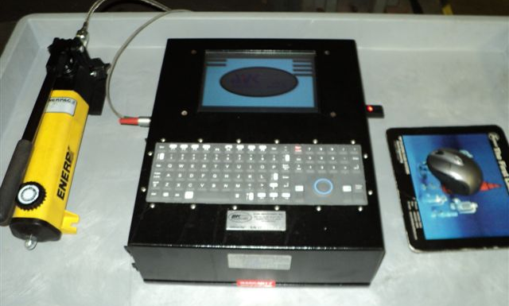
MEC-TRIC
AVK Valve In Place Test System
AVK device illustrating computer with display (center) and hydraulic hand pump stem lifter (left).

Slide 6
MEC-TRIC
AVK Valve In Place Test System
Customer data, set pressure of valve, valve type, valve size, section code is inputted into AVK before valve lift/test process begins. AVK display indicating stem target force value on right (08 value) and pressure applied to stem left (0 value). Valve stem has not been lifted in this display screen. As hydraulic pump is actuated, value on left will increase as stem lift pressure increases. The stem lift pressure will eventually overcome the force of the valve spring and the valve disc will open at the set pressure of the valve, provided the valve is operating correctly.

Slide 7
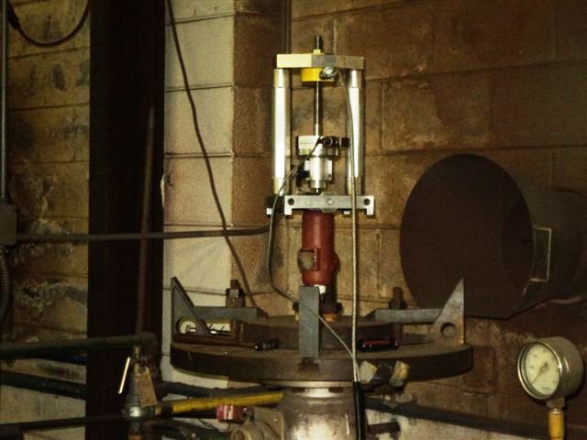
MEC-TRIC
AVK Valve In Place Test System
Pressure sensing device that mounts to valve stem and interfaces with AVK is illustrated below. Each valve type has specific software modeled for the manufacturers type and size of the specific valve.
Load Cell/ Pressure sensing device
Valve

Slide 8
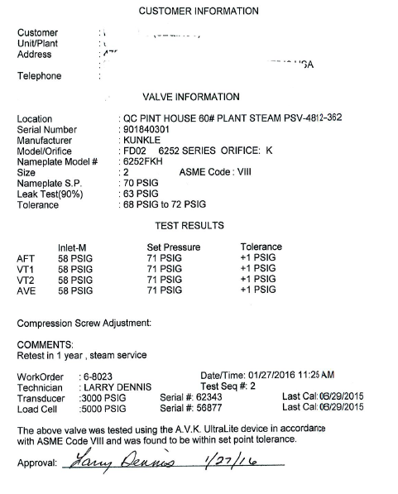
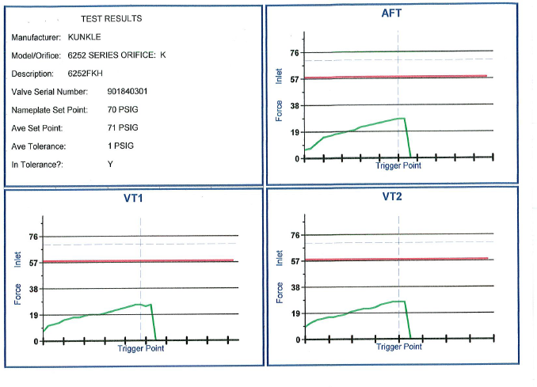
MEC-TRIC
AVK Valve In Place Test System
Test Reports/Graphs for each valve tested are completed as follows:
AFT=As Found Test
VT1 & VT2=Verify test 1&2

Slide 9
MEC-TRIC
AVK Valve In Place Test System
National Board Inspection Code SRV Testing and SRV lift devices – 4.5.1 (2013)
4.5.1 TEST MEDIUM AND TESTING EQUIPMENT
Each valve shall be tested to demonstrate the following:
Set pressure (as defined by the valve manufacturer and as listed in NB- 1B, Pressure Relief Device Certifications);
Response to blowdown, when required by the original code of construction;
Seat tiqhtness; and
For valves designed to discharge to a closed system, the lightness of the secondary pressure zone shall be tested as required by the original code of construction.

Slide 10
MEC-TRIC
AVK Valve In Place Test System
National Board Inspection Code SRV Testing and SRV lift devices – 4.5.3 (2013)
4.5.3 LIFT ASSIST TESTING
A device may be used to apply an auxiliary lifting load on the spring of a repaired
valve to establish the set pressure in lieu of the tests required in NBIC Part 3, 4.5.1a) when such testing at full pressure:
1) may cause damage to the valve being tested; or
2) is impractical when system design considerations preclude testing at full
pressure.
While actual valve blowdown and valve performance characteristics cannot be
verified, valve set pressure may be determined to an acceptable degree of accuracy using this testing technique provided , as a minimum, that:
1) equipment utilized is calibrated as required in the quality system; including, but
not limited to:
a. System pressure measurement equipment;
b. Lifting force measurement equipment : and
c. Other measuring elements required by the device manufacturer.

Slide 11
MEC-TRIC
AVK Valve In Place Test System
National Board Inspection Code SRV Testing and SRV lift devices – 4.5.3 continued
4.5.3 LIFT ASSIST TESTING (continued)
2) the device and test procedures that have proved to give accurate results are
used and followed;
3) a static inlet pressure is applied with the test medium specified in NBIC Part 3,
4.5.1 ; and
4) adjustments are made in accordance with the valve manufacturer's
recommendations to ensure proper lift and blowdown.
c) Prior to use, all lift assist devices shall be qualified by the certificate holder to
ensure that the equipment A13 and testing procedures will provide accurate results
when used within the ranges established for that equipment used for verification
testing as specified in the quality system or comparisons to field performance.
This qualification shall be documented and provisions made to retain such
documentation for a period of at least five years after the lift device is retired.
Documentation of this qualification shall include but not be limited to;

Slide 12
MEC-TRIC
AVK Valve In Place Test System
National Board Inspection Code SRV Testing and SRV lift devices – 4.5.3 continued
4.5.3 LIFT ASSIST TESTING (continued)
A description of the lift assist device including model number, seria l number and manufacturer
2) Size and pressure ranges of valves to be tested with the lift assist device and the test fIuid to be used. Note; Maximum set pressure is determined by available lift force and system pressure.
3) Accuracy of pressure measuring equipment;
4) Method of qualifying.
d) After initial qualification of the device the device shall be re-qualified if:
Modifications or repairs to the device are made Which would affect test results
2) The manufacturer issues a mandatory recall or modification to the device which will affect test results.

